Slide 1


About JS and JSP

Slide 2


Today's session covers....?
1
JavaScript Introduction
2
JSP Introduction
Notes:
では実際に、今日の戦略計画はなぜ複雑なのでしょうか？

Slide 3


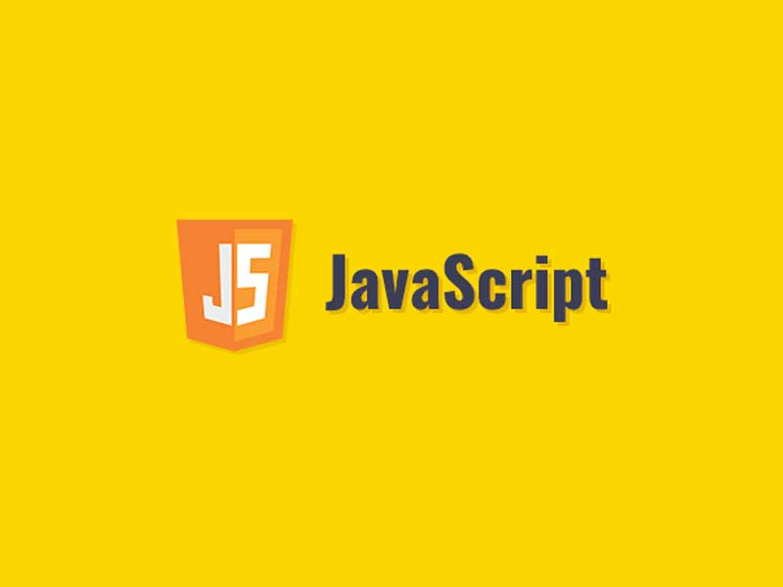

Slide 4


What is JavaSript
JavaScript is a light-weight object-oriented programming language which is used by several websites for scripting the webpages.
It is an interpreted, full-fledged programming language that enables dynamic interactivity on websites when applied to an HTML document.
Extension: filename.js
Features of JavaScript:
JavaScript is a light-weighted and interpreted language.
It is a case-sensitive language.
All popular web browsers support JavaScript as they provide built-in execution environments.
Validating User's Input. JavaScript is very useful while using forms
Platform Independent.

Slide 5
Javascript Concepts:
JavaScript Variable :- A JavaScript variable is simply a name of storage location.
There are 3 ways to declare a JavaScript variable:
Using var
Using let
Using const
JavaScript Functions:
A JavaScript function is a block of code designed to perform a particular task.
A JavaScript function is executed when "something" invokes it (calls it).
Syntax: A JavaScript function is defined with the function keyword, followed by a name, followed by parentheses ().The parentheses may include parameter names separated by commas (parameter1, parameter2, ...). The code to be executed, by the function, is placed inside curly brackets: {}
Example:
function name(parameter1, parameter2, parameter3) { // code to be executed }

Slide 6
Javascript Concepts:
Ajax call: The ajax() method is used to perform an AJAX (asynchronous HTTP) request.
Syntax:$.ajax({name:value, name:value, ... })
Example:
$.ajax({url: "demo_test.txt", success: function(result){ $("#div1").html(result); }});

Slide 7
Jsp Introduction

Slide 8
JSP Introduction:
JSP technology is used to create web application just like Servlet technology. It can be thought of as an extension to Servlet because it provides more functionality than servlet such as expression language, JSTL, etc.
A JSP page consists of HTML tags and JSP tags. The JSP pages are easier to maintain than Servlet because we can separate designing and development. It provides some additional features such as Expression Language, Custom Tags, etc.
Extension: filename.jsp
Advantages of JSP:
1) Extension to Servlet
2) Easy to maintain
3) Fast Development: No need to recompile and redeploy
4) Less code than Servlet

Slide 9
Thank You

